Slide 1

KHAMMAM360 website using WordPress
KHAMMAM360: Building a dynamic website on WordPress for Khammam District, serving as a one-stop platform for public utilities, daily news, and local stories. This site aims to provide a centralized hub for diverse district-related information, including points of interest.

Slide 2
ABSTRACT
Word press is a user friendly content management system that can be used to create websites , applications , blogs.
It is a free open source software based on MYSQL and PHP
Bootstrap is an open source frontend component library for website and web applications development , including the HTML , CSS and JavaScript frameworks.
This presentation delves into the advantages of using WordPress. It unfolds a comprehensive guide covering the selection of an appropriate WordPress theme, the systematic process of creating our website, content integration into the chosen theme, the subsequent launch and promotion of our website, and finally, optimizing it for both performance and SEO.

Slide 3
Benefits of using word press for website creation
>EASY TO USE
WordPress provides a user-friendly interface, making it accessible for beginners and experienced users alike.
With its design and user-friendly features, WordPress makes website creation for all experience levels.
Whether you’re new to web development or a seasoned pro, you'll find that WordPress offers a straightforward and intuitive platform for building websites.

Slide 4
Benefits of using word press for website creation
> Selection of Customizable Themes
WordPress boasts a vast library of customizable themes, allowing to effortlessly personalize the appearance and style of our website.
Modern designs to classic and timeless layouts, there is a wide range of options to choose from that will perfectly suit the vision and personality of our KHAMMAM360 website.

Slide 5
Benefits of using word press for website creation
>Robust Plugin Ecosystem
One of the greatest advantages of using WordPress is its extensive plugin ecosystem.
With thousands of plugins available, easily enhance the website's functionality and add useful features such as contact forms, social media integration, search engine optimization, and more.
This empowers to create a truly dynamic website for our KHAMMAM360 community.

Slide 6
Benefits of using word press for website creation
>Optimized for SEO
Word Press has built-in features that help improve search engine rankings, ensuring our website gets noticed.
By utilizing features such as customizable permalinks, meta tags , WordPress makes it easier for search engines to index our website.
With WordPress, optimize our KHAMMAM360 website for SEO without needing technical knowledge.

Slide 7
Choosing a suitable word press theme
Factors to consider
Exploring key factors like responsiveness, customization options, and compatibility with our KHAMMAM360's brand identity.
Considering the theme's SEO capabilities to ensure our website ranks well in search engine results.
Theme's loading speed and user-friendliness to enhance the overall experience of our website visitors.

Slide 8
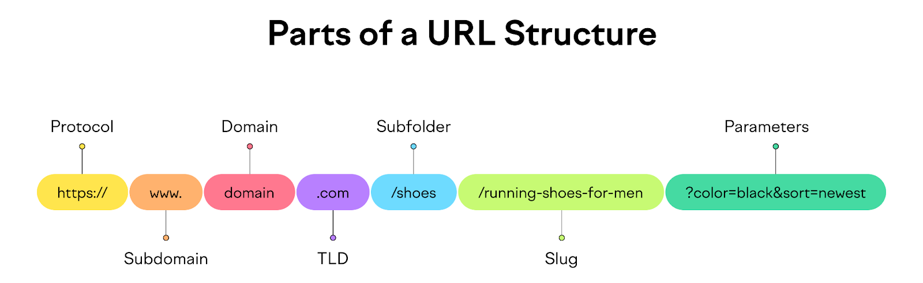
DOMAIN
.COM
Domain name – KHAMMAM360.COM from GO DADDY
A domain name is the name of computer or a group of computers that consists of a string of dot- separated names . It is used to identify the electronic direction of the computer during data transmission.

Slide 9
DOMAIN
.COM
The .com domain is a top-level domain (TLD) originally intended for commercial organizations, but its usage has expanded to include various entities.
Its significance lies in its widespread recognition and credibility, making it a popular choice for businesses seeking a well-established brand image.
Despite its popularity, the selection of a domain depends on factors like website nature and target audience. It's essential to note that other TLDs like .edu, .gov, and .org cater to specific purposes and audiences beyond commercial entities.

Slide 10
STEP BY STEP CREATING OF OUR WEBSITE

Slide 11
STEP BY STEP CREATING OF OUR WEBSITE
Step 1: Define Objectives
Outlining our goals for the website, such as promoting local businesses, highlighting the rich cultural heritage of our KHAMMAM360 , providing digital space for freelancers, sharing community news, job notifications and attracting tourists.

Slide 12
STEP BY STEP CREATING OF OUR WEBSITE
Step 2: Plan Structure & Navigation
Creating a logical website structure and intuitive navigation to ensure visitors can easily explore and find they information they need.

Slide 13
STEP BY STEP CREATING OF OUR WEBSITE
Step 3: Customize Theme (Color news Magazine)
Personalizing our chosen theme by customizing colors, fonts, and layouts to reflect the character of our KHAMMAM360.

Slide 14
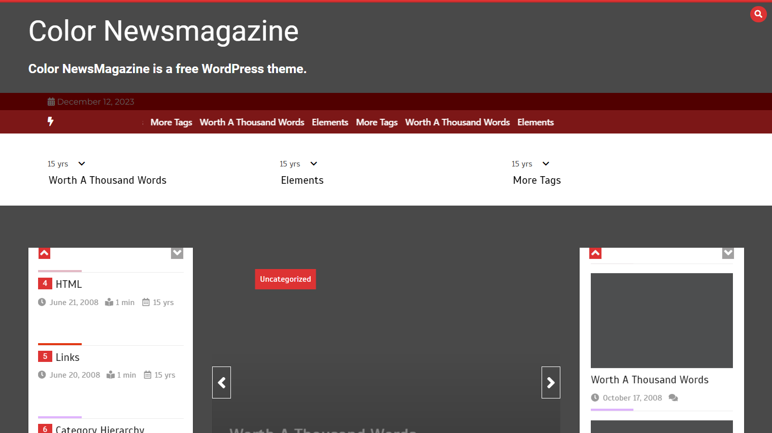
Color news magazine layout

Slide 15
Adding content to our theme

Slide 16
Adding content to our theme
>Customizing pages
>HOME PAGE

Slide 17
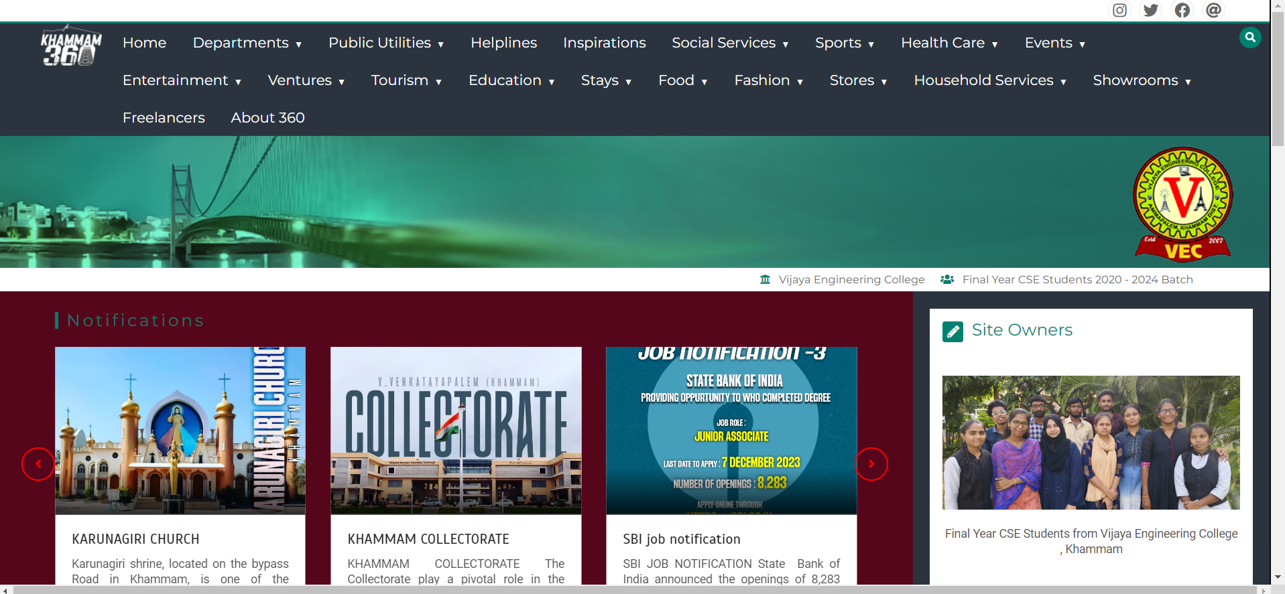
>DESKTOP VIEW

Slide 18
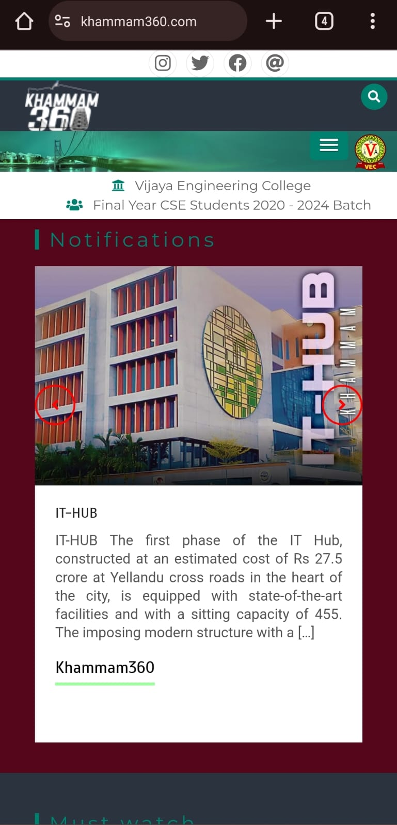
>DESKTOP VIEW
>MOBILE VIEW

Slide 19
Adding content to our theme
>Customizing pages
>HOME PAGE
>ABOUT 360

Slide 20
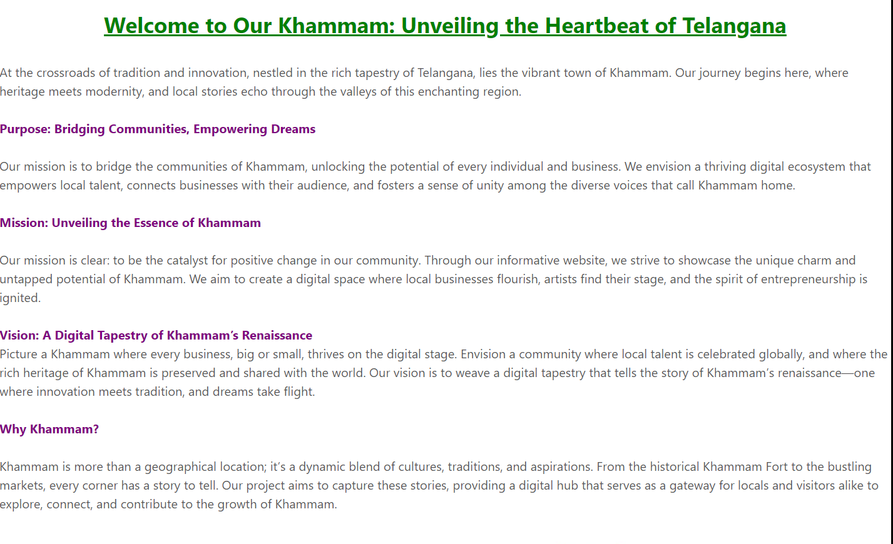
>DESKTOP VIEW

Slide 21
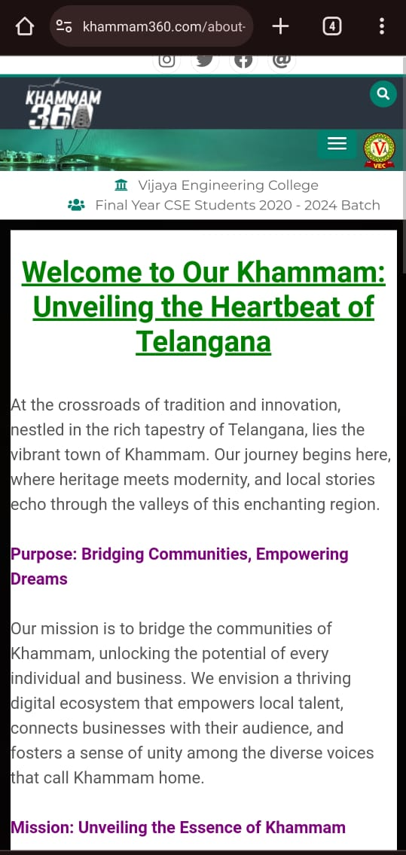
>DESKTOP VIEW
>MOBILE VIEW

Slide 22
Adding content to our theme
>Customizing pages
>HOME PAGE
>ABOUT 360
>NAVIGATION MENUBAR

Slide 23
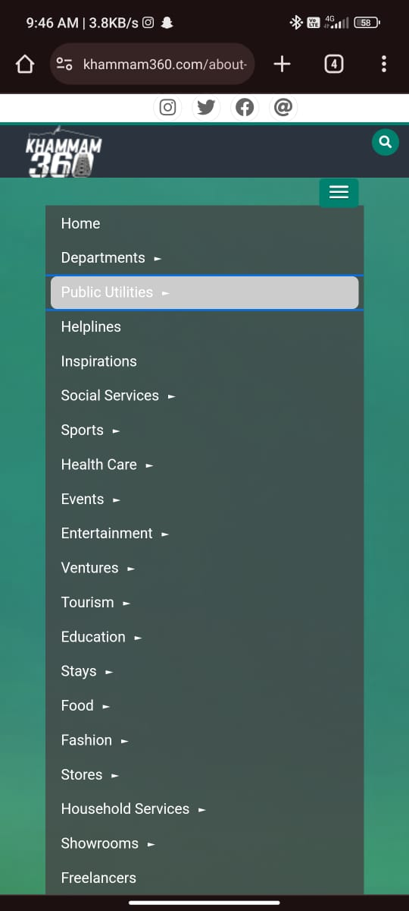
>MOBILE VIEW

Slide 24
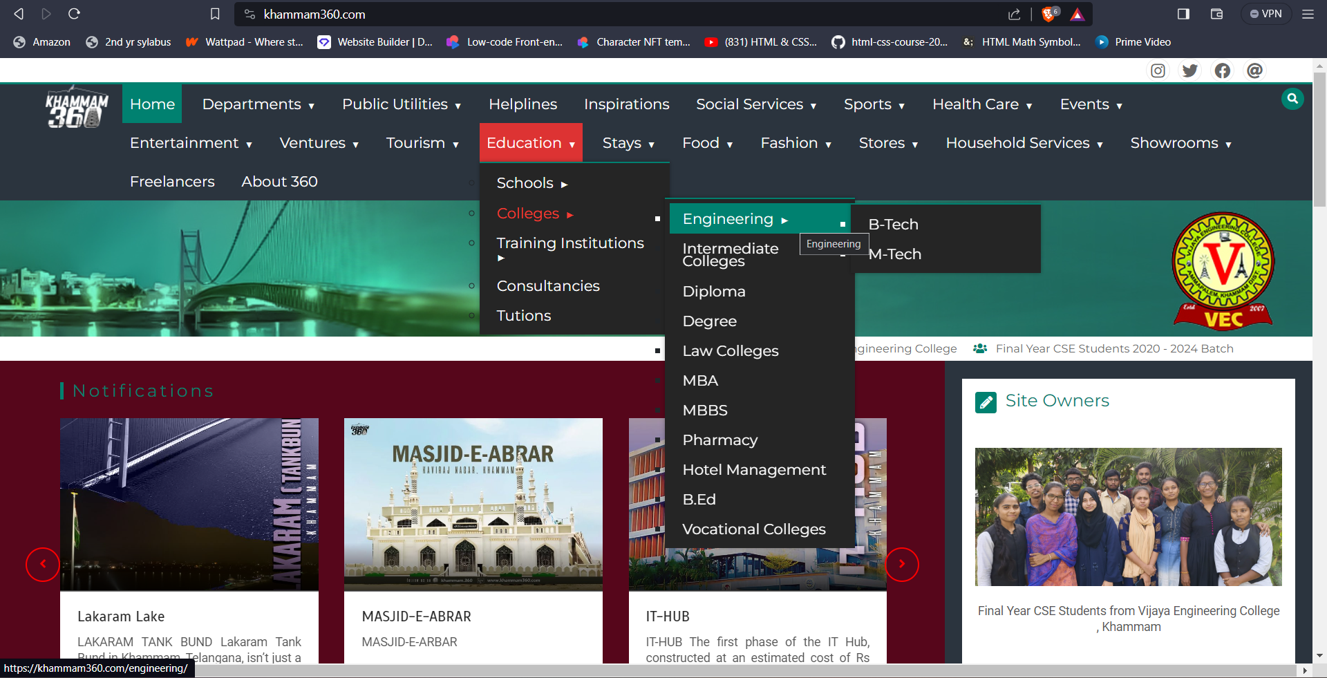
>DESKTOP VIEW
>MOBILE VIEW

Slide 25
Launching and Promoting Our KHAMMAM360 Website
We ensure our website gets the attention it deserves by following a comprehensive launch and promotion strategy. From leveraging social media platforms to collaborating with local influencers, we are unleashing the power of digital marketing to engage and attract visitors from far and wide.

Slide 26
Launching and Promoting Our KHAMMAM360 Website
Social Media Marketing
Utilizing various social media platforms to create buzz and generate excitement about our KHAMMAM360 website.

Slide 27
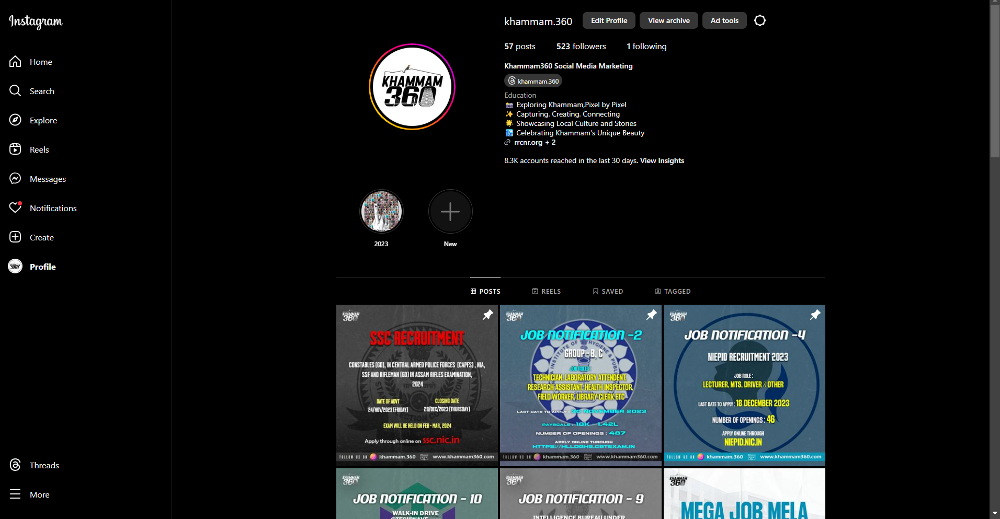
social media platform

Slide 28
Launching and Promoting Our KHAMMAM360 Website
Collaborate with Influencers
Partnering with influential individuals who can help increase the reach and visibility of our website.

Slide 29
Optimizing Our KHAMMAM360 Website for Performance and SEO
Improving Website Speed and Loading Times
Learning how to boost our KHAMMAM360 website's visibility in search engine rankings through effective keyword research and on-page optimization.

Slide 30
Optimizing Our KHAMMAM360 Website for Performance and SEO
User-Friendly Navigation
Discovering best practices for creating an intuitive and easy-to-navigate website structure to enhance user experience and accessibility.

Slide 31
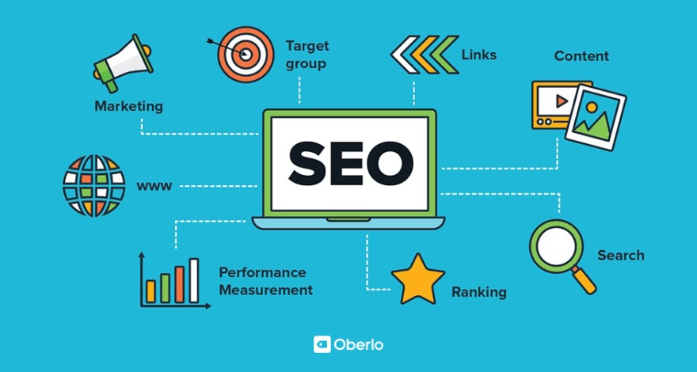
SEO
SEO, or Search Engine Optimization, is the practice of enhancing a website's visibility on search engines like Google.
It involves optimizing content, improving technical aspects, and building authority to rank higher in search results.
The primary purpose is to increase organic (non-paid) traffic to a website.
SEO aims to improve a site's relevance and credibility, leading to better visibility and user engagement.
Ultimately, SEO enhances online presence, driving growth and success for businesses in the digital landscape.

Slide 32
Maintaining Our KHAMMAM360 Website
Testing and Debugging
Learning the importance of thorough testing before the website launch, we ensured a seamless user experience by checking the traffic of our website by logging into it from multiple devices simultaneously, and checking the responsiveness and interactivity of our website

Slide 33
Maintaining Our KHAMMAM360 Website
ON GOING MAINTAINANCE AND WEBSITE
Discovering strategies to keep our KHAMMAM360 website up-to-date, including regular backups and content updates.

Slide 34
We collected the required information for our khammam360 website from these resources
Wikipedia
Google maps
ChatGPT
Gathering information from locals
Lokal app

Slide 35
FUTURE SCOPE
1. Expansive Vision: The website has a dynamic and expansive vision, focusing on enhancing user experience and broadening its reach.
2. Comprehensive Guide: The platform aims to serve as a comprehensive guide to various places, providing users with detailed and up-to-date information.
3. Job Notification Hub: It aspires to become a go-to resource for timely job notifications, helping users stay informed about career opportunities.
4. Bandwidth Expansion: The commitment includes the expansion of website bandwidth for faster and more efficient access to a wealth of valuable data.
5. Interactive Community: The future focus involves creating a seamless and immersive user interface, fostering community engagement, and encouraging active user contributions to meet the evolving needs of a diverse audience.

Slide 36
PRESENTED BY
AI&ML
MD.SULTHANA(20BR1A6630)
P.SAMI(20BR1A6634)
SK.SOHAN(20BR1A6644)
SK.SUBHANI(20BR1A6645)

Slide 37
THANK YOU

